Slide 1
Bryan Krajewski
Ally Mayo
Nicole Oriel
Trevor Smith
Zi Yi Toh

Slide 2
About Us
We are the region's leader in shipping, handling, and processing of everything from small parcels to large packages. We offer cheaper prices over our competitors like UPS and FedEx.

Slide 3
Our Project
The purpose of our project is to build a database for the Human Resources department of WNY Shippers which is headquartered in Buffalo. Our database would replace the outdated system that made use of Microsoft Excel spreadsheets to manage the large amounts of applications and applicants in a tight time frame.
Example: Increased hiring during the holiday season (October to January)

Slide 4
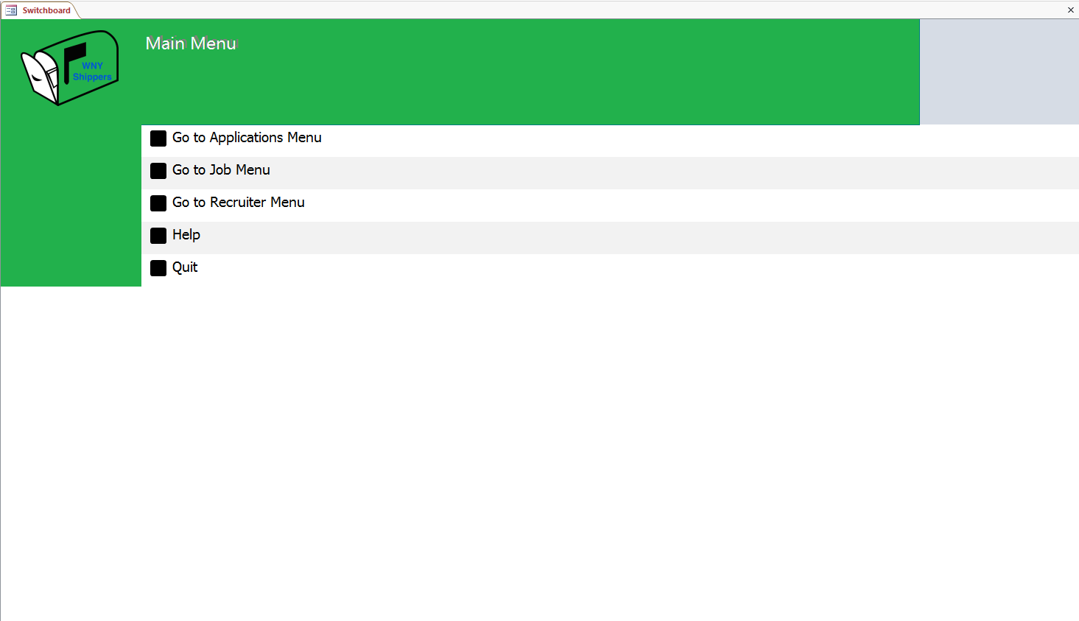
Our Database

Slide 5
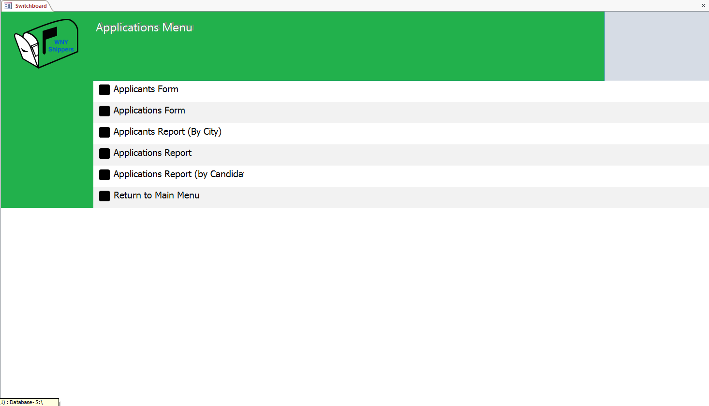
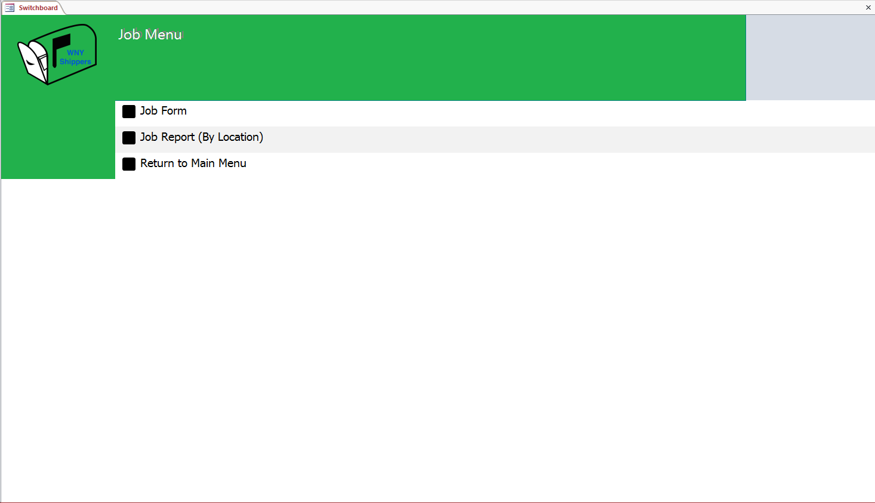
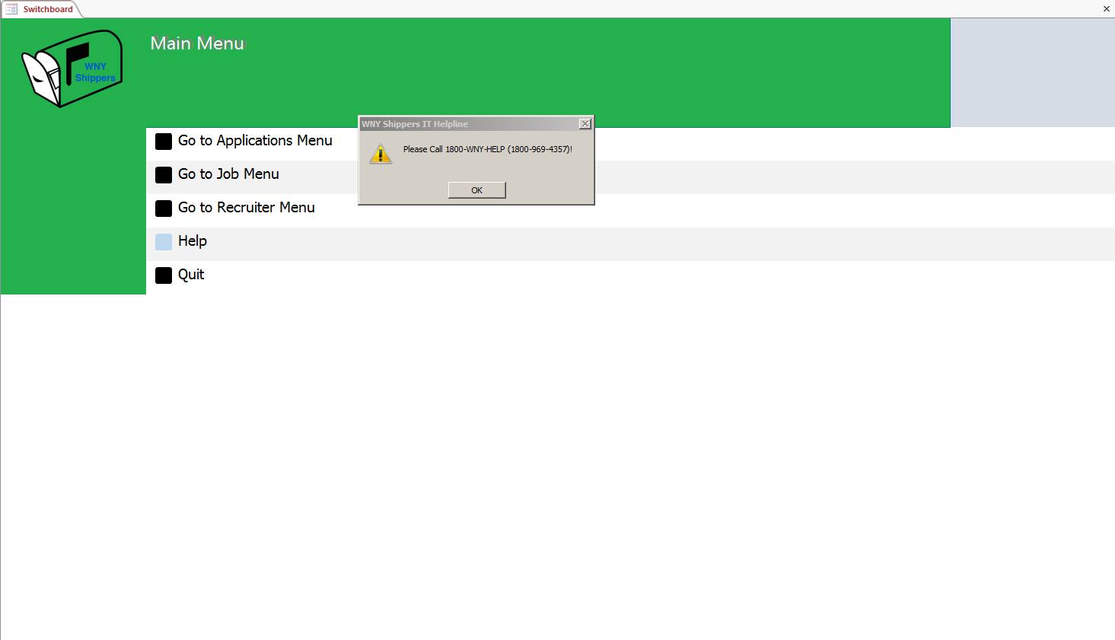

Slide 6
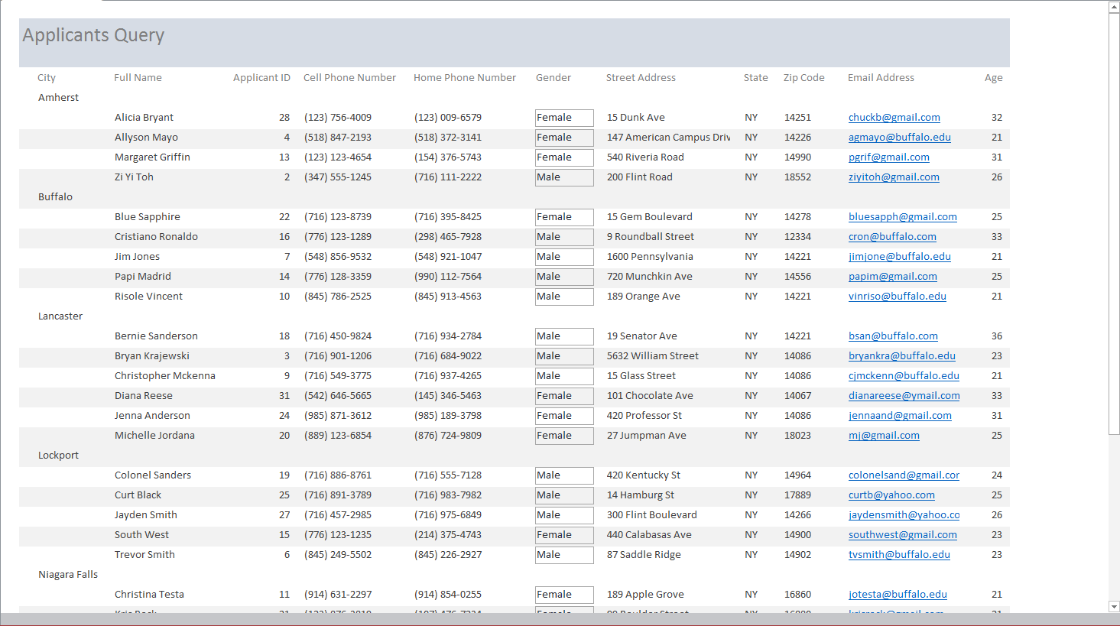
Report 1: Applicants by City

Slide 7
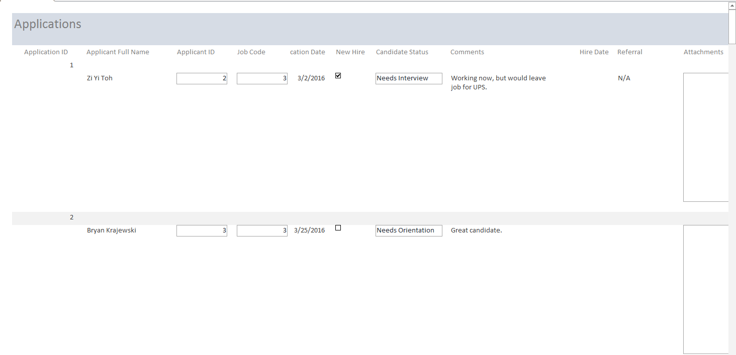
Report 2: Applications

Slide 8
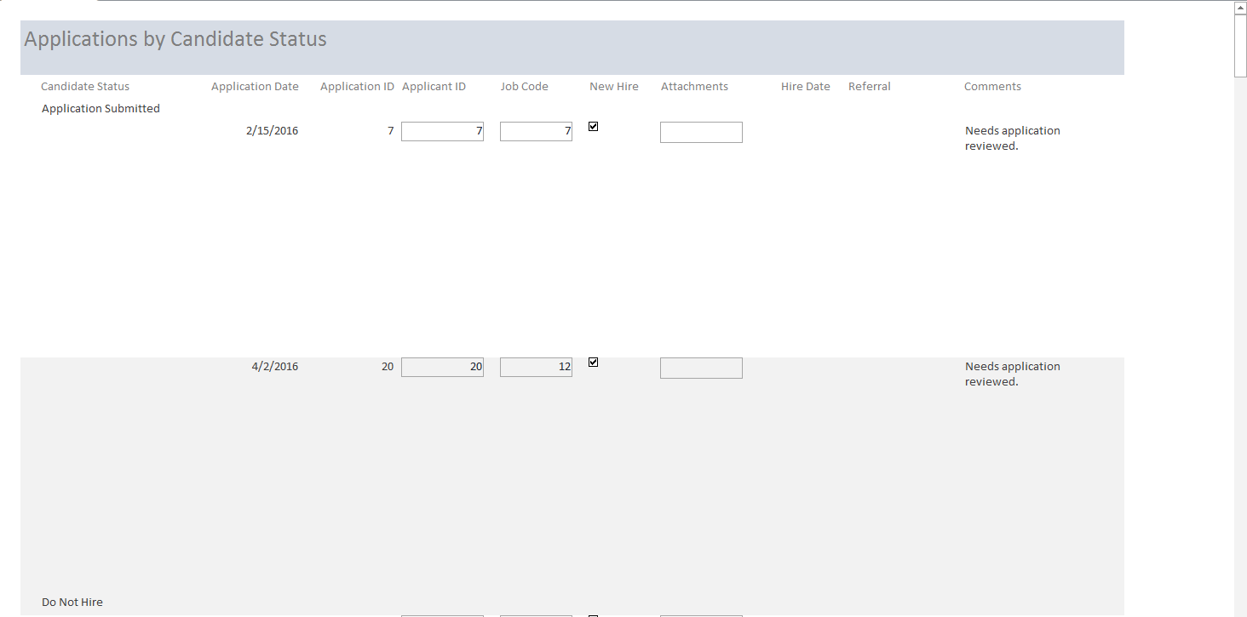
Report 3: Applications by Status

Slide 9
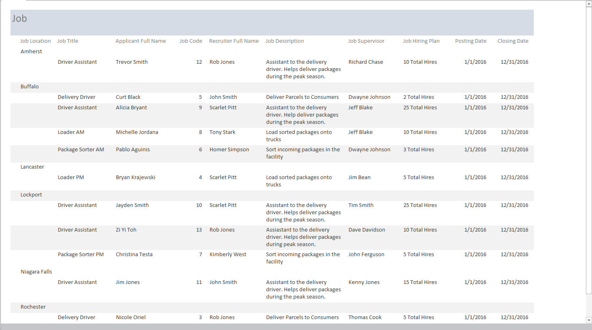
Report 4: Job by Location

Slide 10
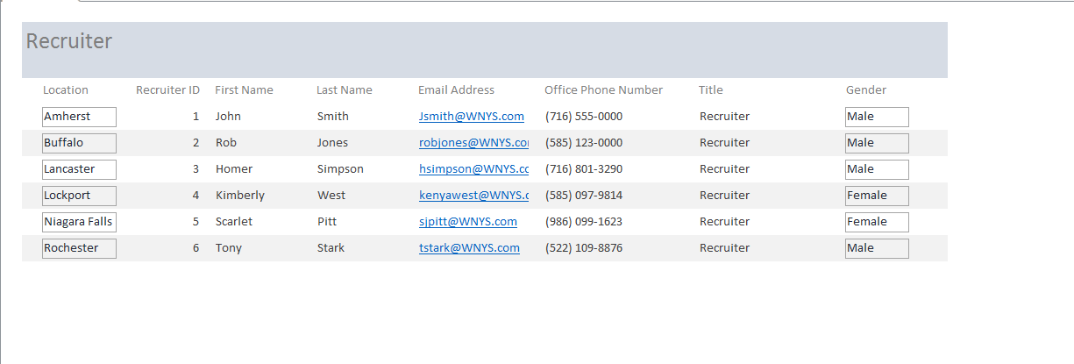
Report 5: Recruiter

